Slide 1




SMART INDIA HACKATHON 2026
TITLE PAGE
  Problem Statement ID –SIH26003
  Problem Statement Title - AI-Based Cognitive Gaming and Memory Assistant
  Theme-MedTech/BioTech /HealthTech
  PS Category- Software
  Team ID-
  Team Name (Mindforge)
01

Slide 2

Mindforge
AI - Based Cognitive Gaming and Memory
A single platform for memory support, cognitive engagement and daily independence.
Cognitive
Games
Personal
Memory
Problem
People with mild memory difficulties can forget medicines, appointments, family details, important events and daily routines. Generic apps are rarely personal or adaptive.
Solution
Smart
Reminders
Caregiver
Dashboard
Our AI-based platform combines cognitive games, personal memory storage, voice support, smart reminders and a consent-based caregiver dashboard.
Personalized support grows from familiar information, accessible interaction and AI-guided activities.
SMART INDIA HACKATHON 2026 · SIH26003
02

Slide 3
Mindforge
TECHNICAL APPROACH
How the system works: from onboarding to continuous personalization.
1. User Registration
2. Profile + Cognitive Baseline
3. AI Creates Cognitive Profile
4. Games + Memory Assistant
5. AI Analyzes Performance
6. Difficulty & Exercises Adjust
7. Reminders + Voice Support
8. Dashboard + Caregiver Feedback
The loop repeats after every session, keeping activities at a comfortable and useful level.
SMART INDIA HACKATHON 2026 · SIH26003
03

Slide 4
Mindforge
FEASIBILITY AND VIABILITY
Features that make the platform useful, accessible and scalable.
📈
Adaptive AI
🧩
🎙️
Cognitive Games
Voice Assistant
Automatically adjusts game difficulty according to performance.
Memory, recall, sequence, pattern and attention activities.
Simple spoken questions and responses for easier navigation.
🗣️
🔔
Smart Reminders
📊
Caregiver Dashboard
Regional Languages
Hindi-first design with expansion to Indian languages.
Medicines, appointments, events and daily routine prompts.
Authorized progress updates and easy-to-read reports.
Suggested Tech Stack
Python + ML | NLP | Speech-to-Text / Text-to-Speech | HTML/CSS/JavaScript or Mobile App | Firebase / MySQL / MongoDB | REST APIs + Cloud
SMART INDIA HACKATHON 2026 · SIH26003
05

Slide 5
Mindforge
IMPACT AND BENEFITS
An accessible AI companion for cognitive engagement and everyday support.
🌱
Cognitive engagement
🧭
Independent routines
Encourages regular, enjoyable mental activities.
Supports medicines, appointments and daily tasks.
🤝
Family connection
🌐
Inclusive access
Allows consent-based progress monitoring.
Voice and regional-language direction improve usability.
User registration · cognitive baseline · adaptive games · personal memory · voice interaction · smart reminders · caregiver dashboard · AI-generated exercises
SMART INDIA HACKATHON 2026 · SIH26003
SMART INDIA HACKATHON 2026 · SIH26003
06
06

Slide 6
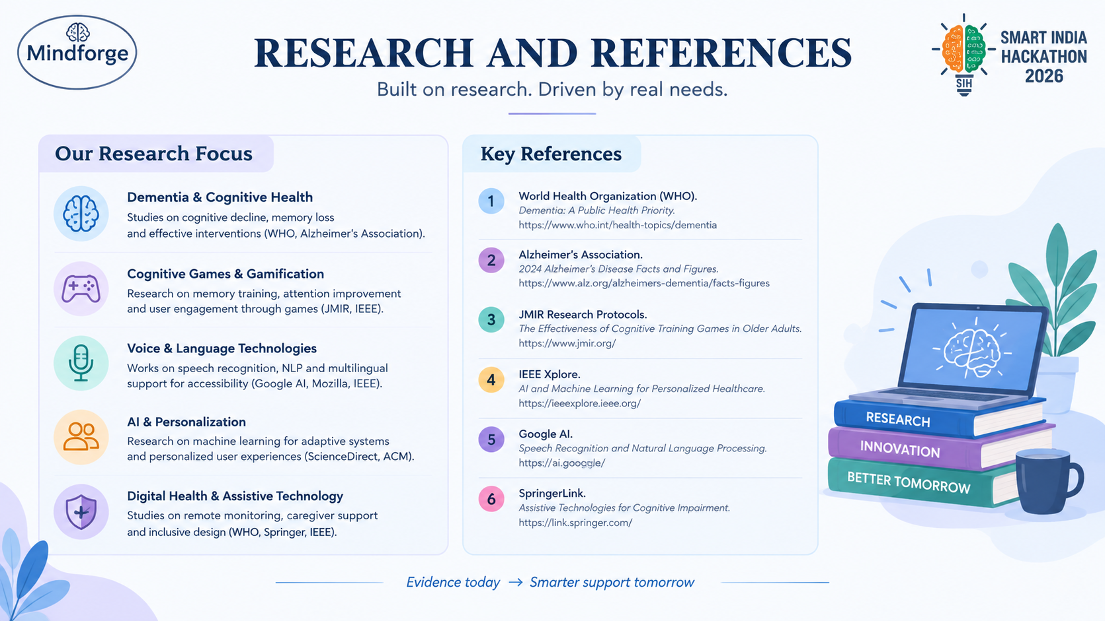
04
SMART INDIA HACKATHON 2026 · SIH26003

